Slide 1
DIGITAL ONLINE IDENTIFIERS
ACCESS AND SERVICE MANAGEMENT FOR THE USERS AND GROUPS

Slide 2
DIGITAL ONLINE IDENTIFIERS
Create unique, personalized Customer Identifiers from your logos/templates
Send personalized Identifiers to Customers’ mobile phone and/or e-mail
Define services that are associated with the Identifiers
Validate and register service use manually or automatically
Publish services to the Online Store with a single click (REST API)
Control access, register sales and monitor&track use of services
Automatic reporting and integration with major Newsletters programs
Cloud service is accessible with any Internet Browser/mobile device/API
Data is securely stored regionally and is fully GDPR and PSD2 compliant

Slide 3
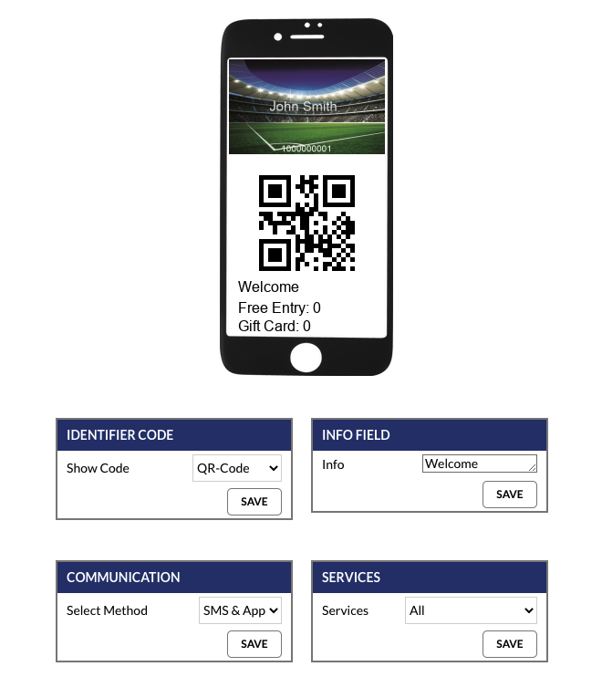
CREATE UNIQUE IDENTIFIERS
UPLOAD YOUR OWN CARD TEMPLATES OR LOGOS
PERSONALIZE IDENTIFIERS WITH RECIPIENTS’ PROFILES
ADD OPTICAL CODE FOR FAST MACHINE READING
SHOW CUSTOMER’S REAL-TIME SERVICE STATUS

Slide 4
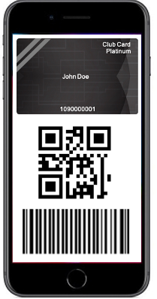
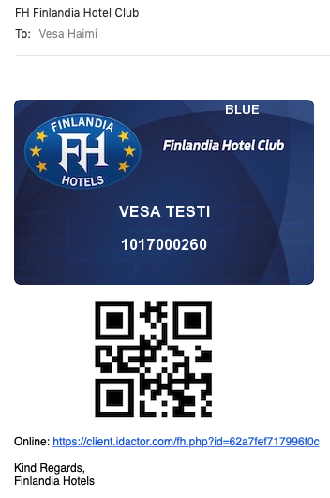
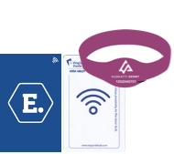
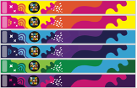
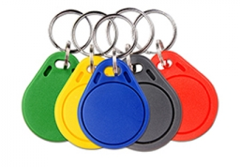
DELIVERING IDENTIFIERS
SMS -> Internet Browser
EMAIL
TRADITIONAL CUSTOMER MEDIA
Works with any mobile device.
No need for applications!
Immediate delivery to email
Use traditional media in parallel
while moving towards full digitalization.

Slide 5
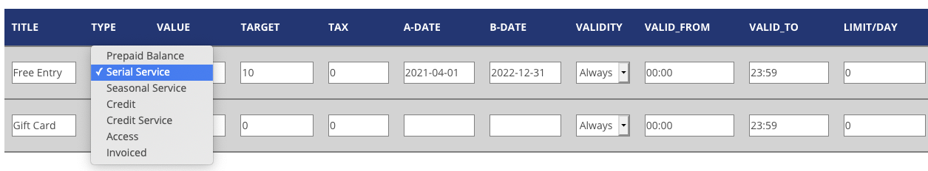
SERVICES FOR THE CUSTOMERS
Define services that are used/validated with the identifiers.
Services can be quantity, balance and time based, e.g.:
  Access to certain flight / boat / tram / room / event / seat
  Access to VIP lounge, Fast-track line, cabinet, restroom,…
  10x serial access to Spa, 5x breakfast valid from Mon-Fri
  Season/VIP pass
  Gift Card with any amount and set expiry date
  Attendance registration to specific class or hobby
  Limited/free access for specific doors/gates/lockers
Cooperation with other systems via REST API
Services can be easily activated for individuals, groups or masses

Slide 6
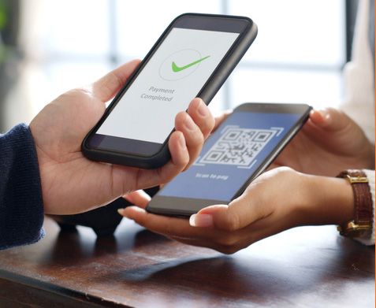
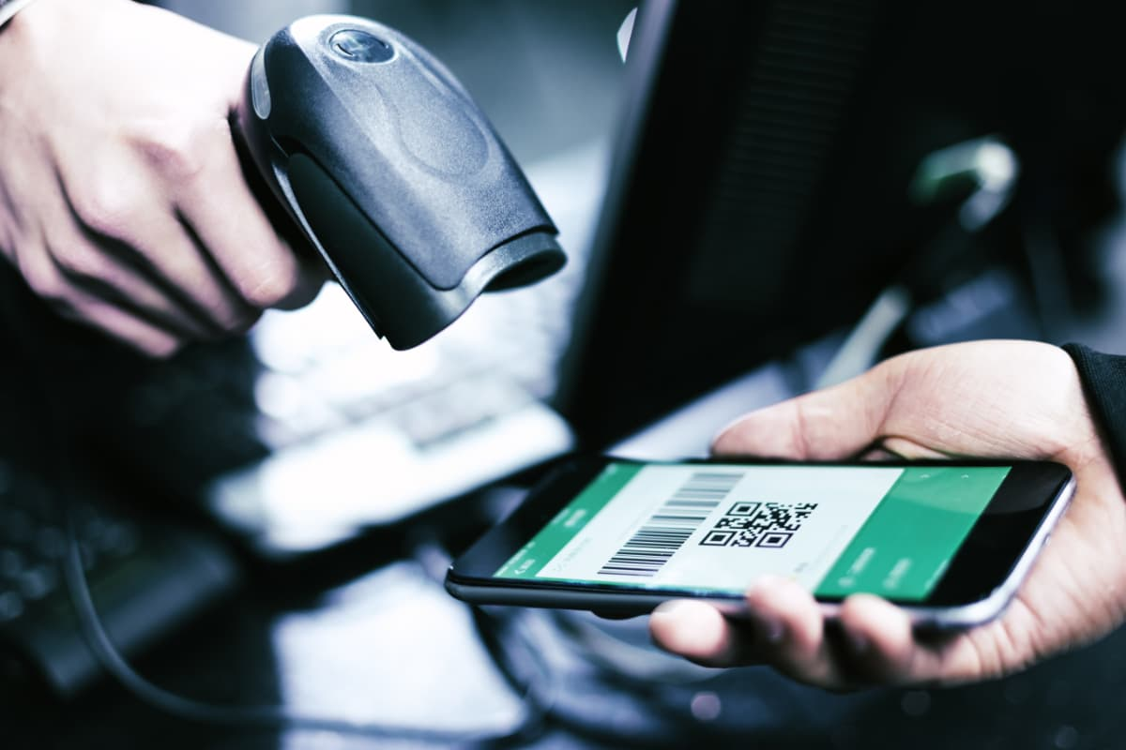
VALIDATING IDENTIFIERS
&
USING SERVICES
USE ANY MOBILE DEVICE
NO NEED FOR APPLICATIONS!
USE A BARCODE SCANNER
ATTACHED TO A TABLET OR COMPUTER
OR
INTEGRATED READER WITH A RELAY

Slide 7

LOYALTY AND REWARDING
The in-built loyalty and membership program:
Easy to use customer registry and transaction registration
Collecting and using points
Freely set membership levels and point multipliers
Automated level changes and point expiry
Integration with Newsletter programs
Use of points and gift cards through e-commerce service
Automated reporting for the key personnel
Using digital identifiers provides many benefits, including
Easy to manage, no material or posting costs
Ecological and sustainable way operating a loyalty program
Services and balances can be easily updated and activated
Monitoring and tracking customer activities in real-time
Superior customer satisfaction and high enrolment rate

Slide 8
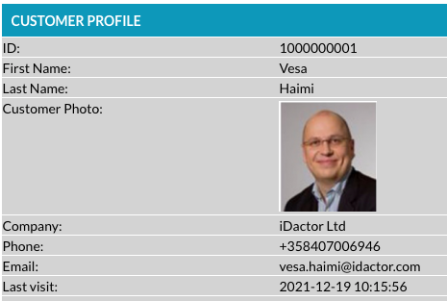

IDENTIFIERS WITH A PHOTO
Customer photo can be added to the identifier and/or show with online validation
This provides additional secure way to identify your employees and customers
Photos can be added individually, through mass-import interface or REST API

Slide 9
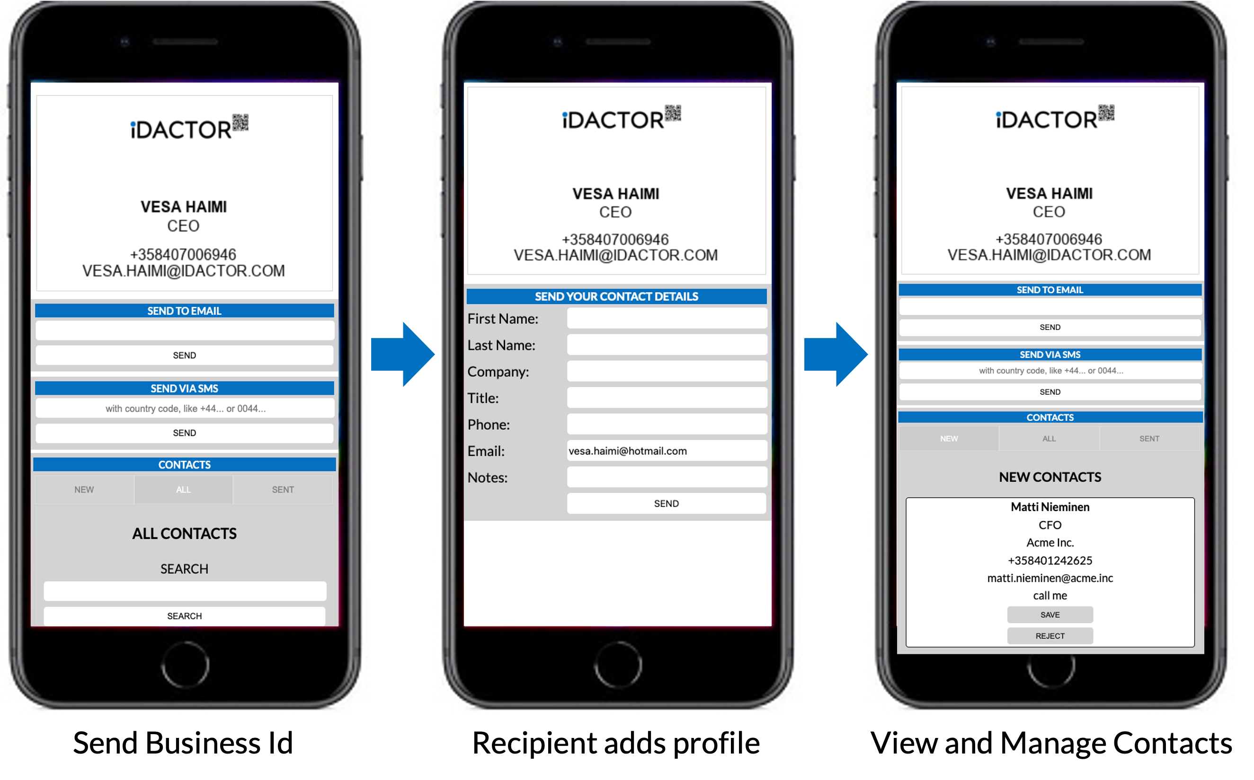
DIGITAL BUSINESS CARDS
”OPERATING AND MANAGING TRADITIONAL BUSINESS CARDS IS CUMBERSOME AND NON-ECOLOGICAL”

Slide 10

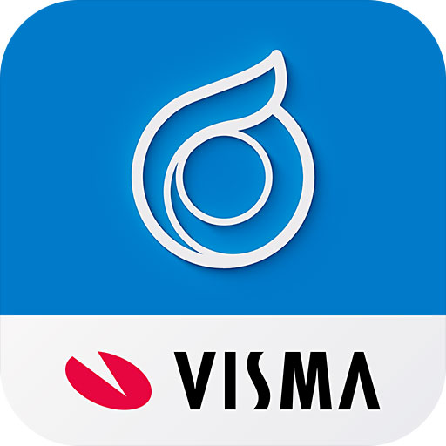



REPORTING AND API
Well-documented, multi-purpose REST API
Real-time monitoring and statistics available locally, as automated scheduled email reports or via REST API
Easy integration with e-commerce systems to enable automatic identifier submit after successful purchases.
Interfaces for major newsletter programs, business analytics tools and accounting systems
Provides detailed real-time data for 3rd party Business Analytics for fact-based decision making

Slide 11
USE CASE:
SPORT CLUB
THE PROBLEM
“
Season cards are made of non-recyclable PVC plastic and must be printed and delivered to customers every year. Customers make all their payments with cash or with posted paper invoice.
This will cause a huge workload, printing physical cards is expensive and posting cards is cumbersome and non-ecological. There are also a lot problems with canceled reservations, delayed payments and with last-minute changes.
Our VIP customers are continuously complaining that the received service quality is poor.
We also have issues with our junior players; How to validate their annual member fee payments and easily register the attendance to practices.
The cooperation with our partners and sponsors is done the same way as for decades; there is no tracking or statistics how much our members are using the given member benefits and partner services.
“
THE SOLUTION
Idactor Online Identifiers are sustainable and ecological. They are delivered to customers mobile phone and/or email in a digital form so the managing them is easy and there is not need for posting. The digital identifiers can be changed anytime and re-send to customers.
The service can be integrated with the e-commerce so that identifiers are sent automatically to the customers after successfully completing the payment.
The system services can be activated at the same time, including access permissions, drink coupons and other included benefits.
The identifiers can be validated online either manually or automatically for access control, attendance monitoring, service redemption or register payments.

Slide 12
USE CASE:
HOTEL CHAIN
THE PROBLEM
“
Our hotel chain operates in 8 countries and in total of 45 locations. Our loyalty program contains over 400 000 members and is based on locally installed software and plastic cards. We are shipping more than 100 000 physical cards annually. The current loyalty system is getting outdated and lacks modern functions, like integration to our online shop and automated customer messaging.
We would also like to have chain-wide gift-cards integrated into the same system and provide possibility to pay online reservations with the gift-cards among with collected points.
We have also high demands for the hotel specific, country specific and chain wide reporting.
And everything should work in real-time.
“
THE SOLUTION
Idactor Cloud based system is available 24/7 from any location. System is secure, fully redundant and GDPR and PSD2 compliant. Idactor identifiers are also an ecological option because they are delivered to customers in digital form. Managing Customer Identifiers and customer profiles happens in real-time.
The system has in-build membership functionalities, including membership levels and points (earn and use). Generic in-house services can be added to cover the entire chain (e.g., gift-cards) and each hotel can easily add their own in-house services to the system, e.g., serial ”card” for lunch, gym and spa. System reporting can be automated with a schedule.
Idactor REST API provides versatile communication channel for any 3rd party application, including reservation systems, CRMs and cash-registers.

Slide 13
USE CASE:
ACADEMIC INSTITUTION
THE PROBLEM
“
We provide various educational services including class-rooms teaching for primary and secondary school students, afternoon classes for adults and different types of evening activities (sports & arts).
We have canteens that provide breakfast, lunch and cafeteria services. We also regularly host different types of special events; providing space, catering and accommodation.
We would like to have easy to use system to control and manage access to the premises during different times of the day. Also managing the provided restaurant services for the pupils, teachers and visitors should be digitalized to make the service faster, more convenient and to prevent misuse.
Increasing the security of our personnel and students is important; access to the premises should be better controlled and it should be easy to identify and authenticate people inside of our premises.
“
THE SOLUTION
The digital and personalized Customer identifiers can be easily sent to the students, teachers and other visitors. Idactor system provides possibility to handle customers individually or in groups – this makes it easy to activate different types of services either for a single user or for the several people at once.
The services can be activated for different needs, including access to different areas and limited by time, serial lunch service and prepaid or credit balance for the purchases. Identification verification and service registration/redemption can be done manually or automatically.
The system can be integrated with a student management systems to provide up-to-date information about active students and their entitlement for the provided services.

Slide 14

REFERENCE CUSTOMERS

Slide 15
IDACTOR LTD.
Finland
contact: Vesa Haimi
email: vesa.haimi@Idactor.com
phone: +358 40 7006946
Corporate
Idactor Oü
EE102406308
web: www.idactor.com
shop: shop.Idactor.com
email: contact@idactor.com
phone: +358 40 1242625
www.linkedin.com/company/Idactor/

