Slide 1
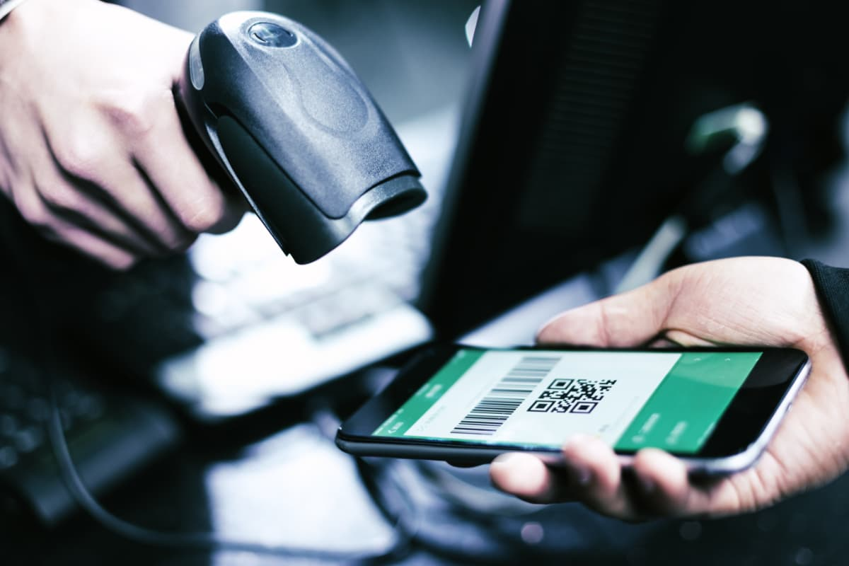

IDACTOR
DIGITAL IDENTIFIERS
WITH ONLINE SERVICE VALIDATION
Cloud based Service, access with any Internet Browser/Mobile Device/API
Create Your Unique Customer Identifiers from your logos/templates
Send Personized Identifiers to Customer’s Mobile Phone and e-mail
Define Services that are associated with the Identifiers
Manual or Automatic Service Validation and Access Control
Publish Services to the Online Store with a single click
Identifiers are sent and activated automatically after successful payments
Control Access, Register Sales and Track use of Services
Automated Reporting and Customer Messaging

Slide 2

ECOLOGICAL AND SUSTAINABLE
SINCE THE 1950s,
HUMANS HAVE CREATED OVER 8 BILLION TONS OF PLASTIC,
WITH UNDER 10% OF IT ENDING UP RECYCLED
EVERY YEAR,
ABOUT 6 000 000 000 PLASTIC CARDS ARE PUSHED OUT INTO THE ENVIRONMENT,
WITH MOST OF THEM MADE BY UNRECYCLABLE PVC PLASTIC.
THERE ARE 10 000 000 000 PLASTIC GIFTS CARDS PRINTED EACH YEAR,
REQUIRING 5500 TONS OF PLASTIC TO CREATE THEM.
THIS EQUATES TO 200 000 TONS OF CO² BEING RELEASED INTO THE ATMOSPHERE.
SOLUTION: DIGITAL CUSTOMER IDENTIFIERS

Slide 3
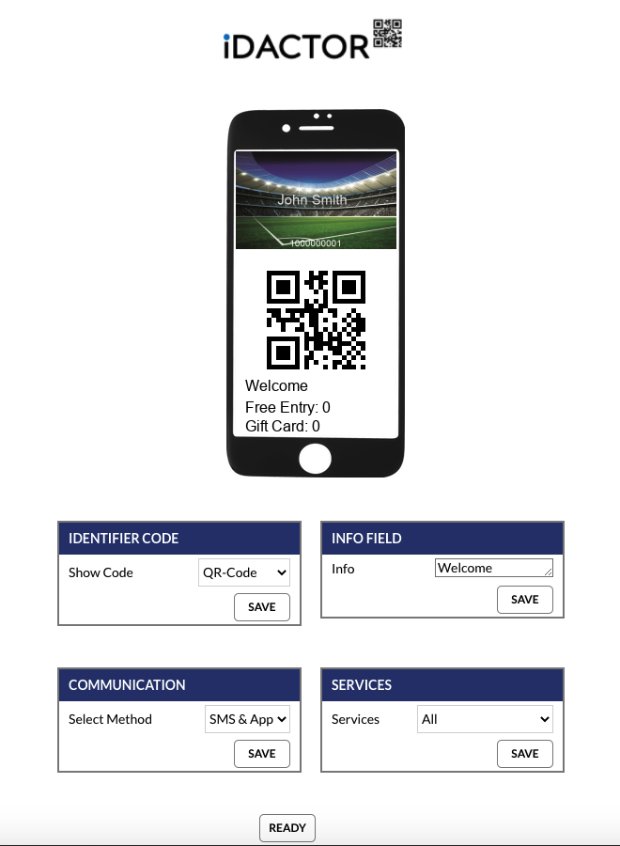
DESIGN AND CREATE UNIQUE IDENTIFIERS
UPLOAD YOUR OWN CARD TEMPLATES OR LOGOS
CREATE PERSONALIZE IDENTIFIERS FOR YOUR CUSTOMERS
USE OPTICAL CODES FOR FAST MACHINE READING
SHOW CUSTOMER’S REAL-TIME SERVICE STATUS

Slide 4
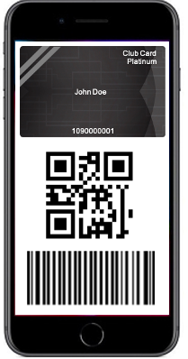
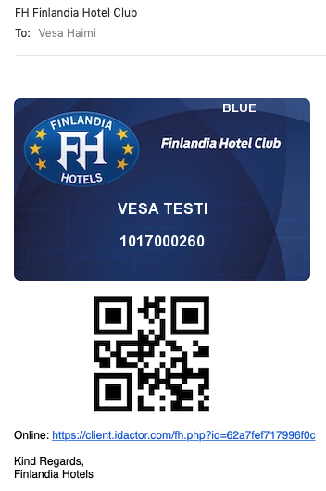
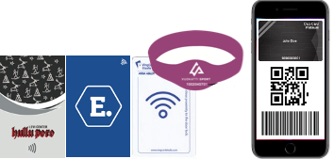
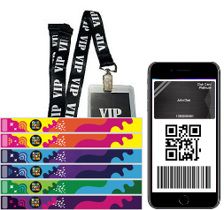
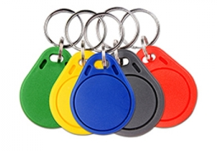
DELIVERY TO ANY MOBILE DEVICE,
EMAIL OR APPLICATION
Use traditional media in parallel…
Works with any mobile device.
No need for applications!
…while moving towards full digitalization
The Online Identifier can also contain real-time status information about the services

Slide 5
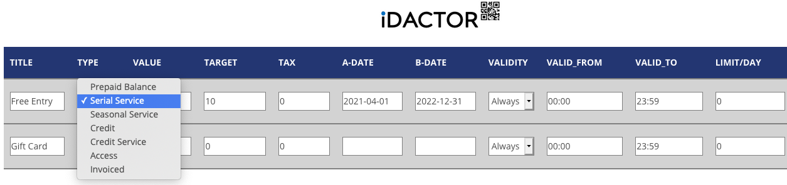
DEFINE YOU IN-HOUSE SERVICES
Define services that are used/validated with the identifiers.
Services can be quantity, balance and time based, e.g.:
  Access to certain flight / boat / tram / room / event / seat
  Access to VIP lounge, Fast-track line, cabinet, restroom,…
  10x serial access to Spa, 5x breakfast valid from Mon-Fri
  Season/VIP pass
  Gift Card with any amount and set expiry date
  Attendance registration to specific class or hobby
  Limited/free access for specific doors/gates
Cooperation with other systems via REST API
Services can be easily activated for individuals, groups or masses

Slide 6
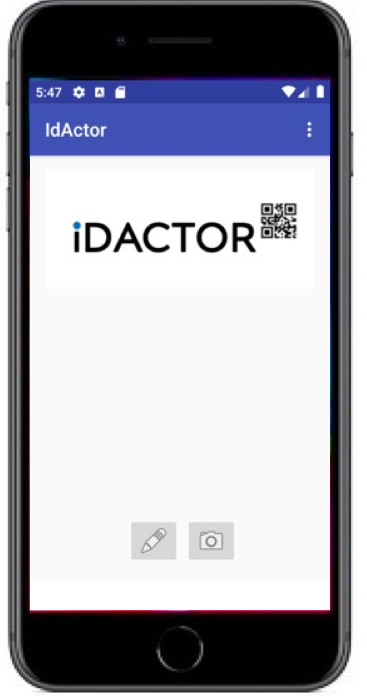
VALIDATE USERS AND SERVICE USE
IN REAL-TIME
Validation is done in real-time automatically or manually
Use any mobile phone to validate identifiers and services
NO NEED FOR APPLICATIONS!
Validation works also with a barcode reader and any internet browser
Validation can be automated to control gates/doors/vending machines
Other systems can be easily integrated through easy-to-use REST API
Traditional media can be used in parallel with digital identifiers

Slide 7
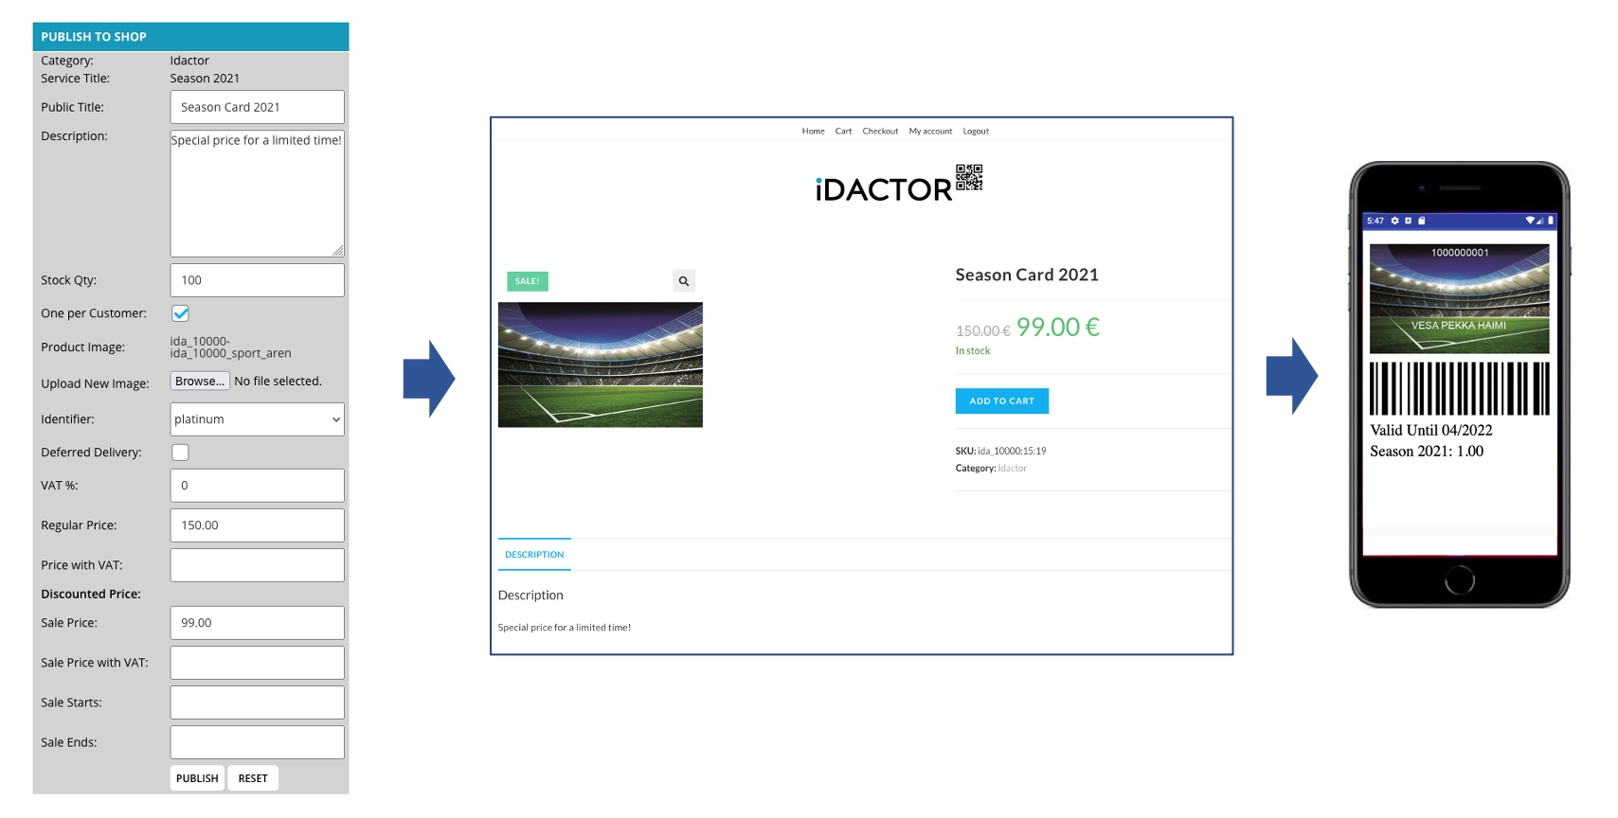
PUBLISH TO ONLINE STORE
WITH ONE CLICK
The Service is automatically activated, and the Identifier is sent to the Customer upon completed payment
Works with Idactor Online Store and
with any existing e-commerce site via API
CONVENIENT FOR ANY SERVICE PAYMENT, INCLUDING MEMBERSHIP FEES, SEASON CARDS, GIFT CARDS AND TICKETS

Slide 8
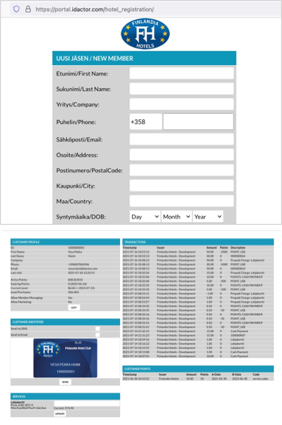
MANAGING USERS
Branded with your own logo
CUSTOMIZED REGISTRATION –FORM
and
MASS-LOAD INTERFACE
Customized Form fields
Customer profiles can be accessed in multiple ways:
Management view
Manual Sales Registration view
Manual access/participation registration
Automated service use/access
Via REST API
MANAGEMENT VIEW FOR THE CUSTOMER’S DATA

Slide 9

LOYALTY AND REWARDING
The in-built loyalty and membership program with all requires functionalities:
Easy to use customer registry
Collecting and using points
Freely set membership levels and point multipliers
Automated level changes and point expiry
Integration with Newsletter programs
Use of points and gift cards through e-commerce service
Automated reporting for the key personnel
Using digital identifiers provides many benefits, including
Easy to manage, no material or posting costs
Ecological and sustainable way operating a loyalty program
Services and balances can be easily updated and activated
Monitoring and tracking customer activities in real-time
Superior customer satisfaction and high enrolment rate

Slide 10



REPORTING, STATISTICS AND
CUSTOMER MESSAGING
Real-time monitoring and statistics
Validated service usage reports for invoicing and clearance
Automated, scheduled reporting to selected emails
Interfaces ready for selected newsletter programs, business analytics tools and accounting systems
Enables efficient customer communication, real-time or scheduled, to individuals or selected customer segments
Provides detailed real-time data for 3rd party Business Analytics for fact-based decision making

Slide 11






USE CASES

Slide 12

TECHNOLOGY
Secure and scalable service in Amazon Cloud
Fully redundant and easy to manage
Geographically distributed
All communication is secured, using SSL (HTTPS)
Well documented, easy to use REST API for 3rd party systems
Commonly used technologies and programming languages
SMS delivery to 207 countries
Compliance with PSD2 and GDPR

Slide 13
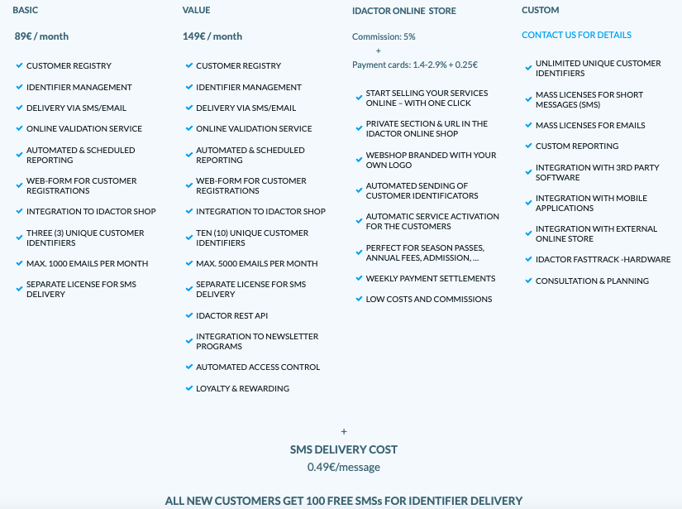
SERVICE PRICING
ALL LICENSES CAN BE PURCHASED DIRECTLY FROM THE IDACTOR ONLINE STORE.

Slide 14

REFERENCE CUSTOMERS

Slide 15
IDACTOR LTD
Idactor Oü
EE102406308
Tallinn, Estonia
Helsinki, Finland
web: www.idactor.com
email: contact@idactor.com
phone: +358 40 1242625

